Slide 1
JWST mission status
Colin Jacobs
JWST MASTER CLASS MELBOURNE 2022

Slide 2
Acknowledgements
All along this presentation you will see results from work conducted by a large number of teams in Europe, USA and Canada.
Most elements of this presentation are based on existing presentations prepared by other members of the JWST project, the instrument teams and STScI.

Slide 3
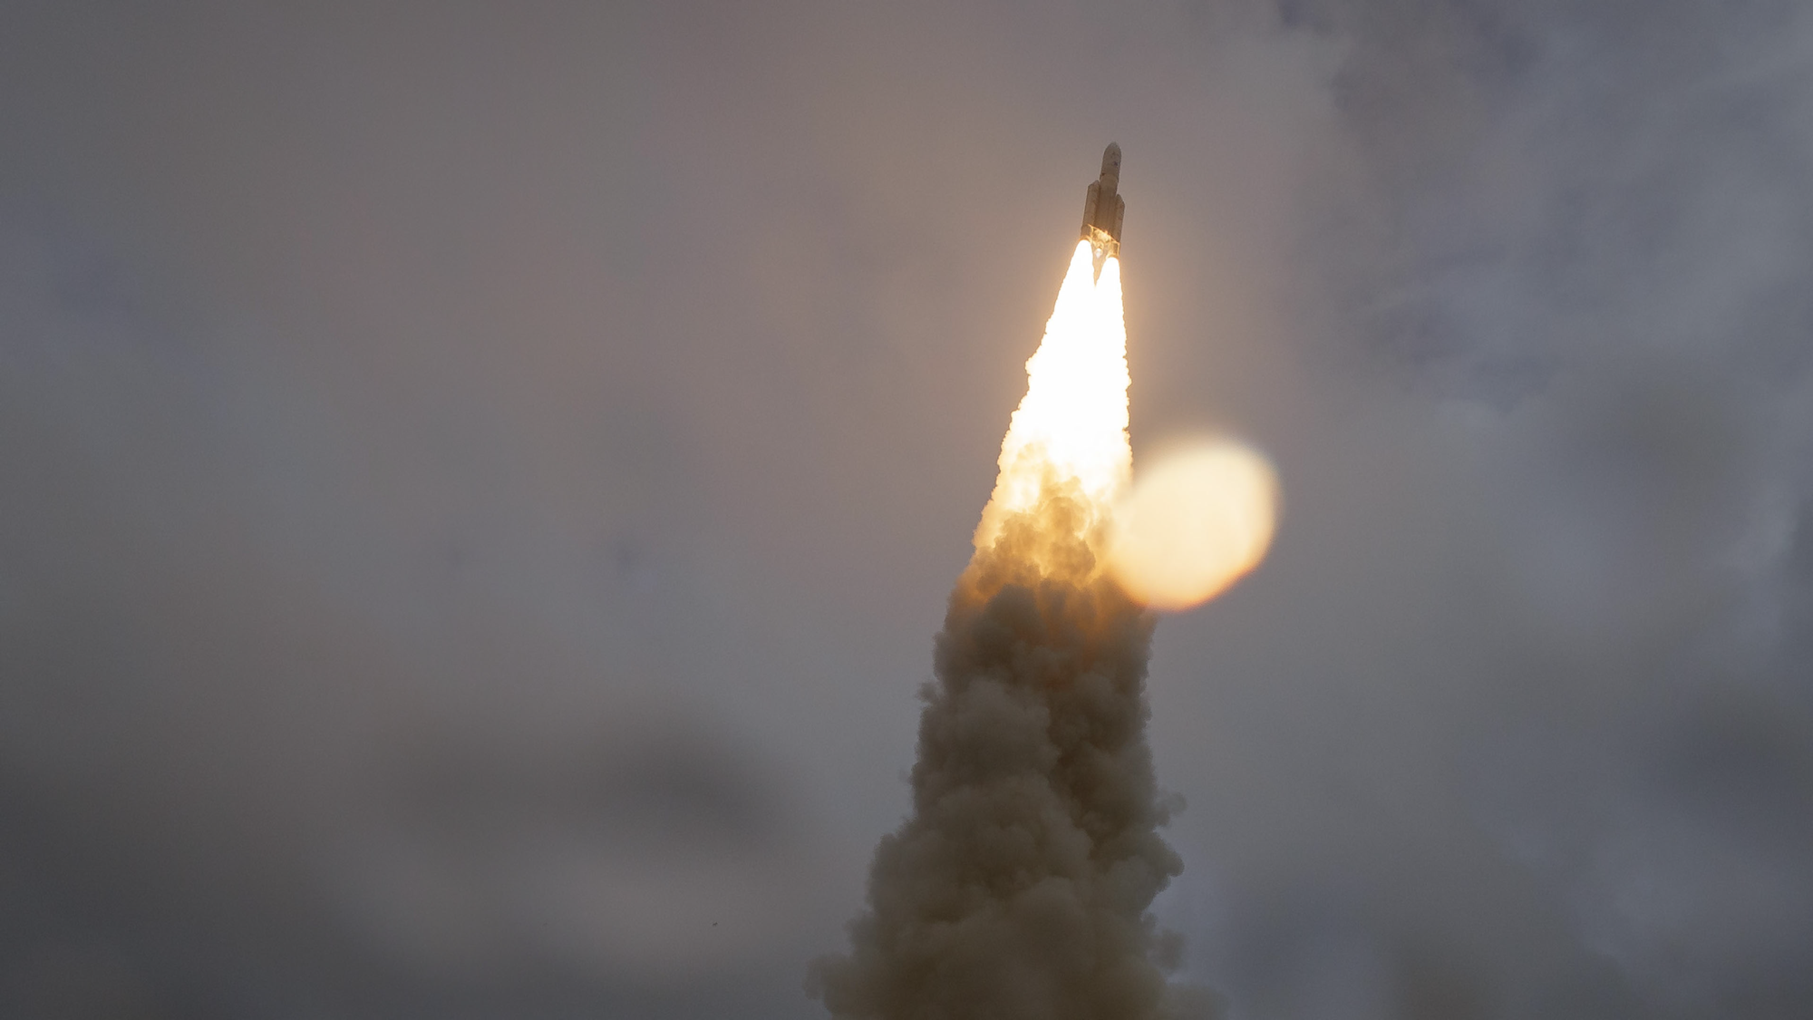
Lift Off!
Notes:
In the pre-dawn hours of Saturday, December 25, 2021, eyes around the world were on the sky.
NASA’s James Webb Space Telescope launched at 7:20 a.m. Eastern Standard Time on an Ariane 5 rocket from Europe’s Space Centre in French Guiana, South America.
Webb is the world’s largest and most complex space science observatory. It will study infrared light from celestial objects with much greater clarity than ever before.
Webb is the scientific successor to NASA’s iconic Hubble and Spitzer space telescopes, built to complement and further the scientific discoveries of these and other missions.
Because infrared light travels through dense gas clouds that block visible light, Webb will reveal previously hidden regions of the universe, helping us solve mysteries in our solar system, look beyond to distant worlds around other stars, and probe the mysterious structures and origins of our universe and our place in it.
[Note to presenter: We recommend pausing your presentation to play the launch video from 0:00-1:15]
__________________________
Resources:
Launch news release: https://webbtelescope.org/contents/news-releases/2021/news-2021-068
Launch video: https://webbtelescope.org/contents/media/videos/2021/068/01FRV8GH9C7ZJP2FAAJEEMQCPZ
Launch image: https://webbtelescope.org/contents/media/images/2021/068/01FQRWPPYBN2QP96MXJGMT5TRE?news=true
Where Is Webb? interactive:
https://www.jwst.nasa.gov/content/webbLaunch/whereIsWebb.html
Full launch broadcast:
https://www.youtube.com/watch?v=7nT7JGZMbtM
Webb Flickr album: https://www.flickr.com/photos/nasawebbtelescope/albums/72157720000770033
__________________________
Image Credit: NASA, Bill Ingalls
https://www.flickr.com/photos/nasawebbtelescope/51787852384/in/album-72177720296738159/

Slide 4
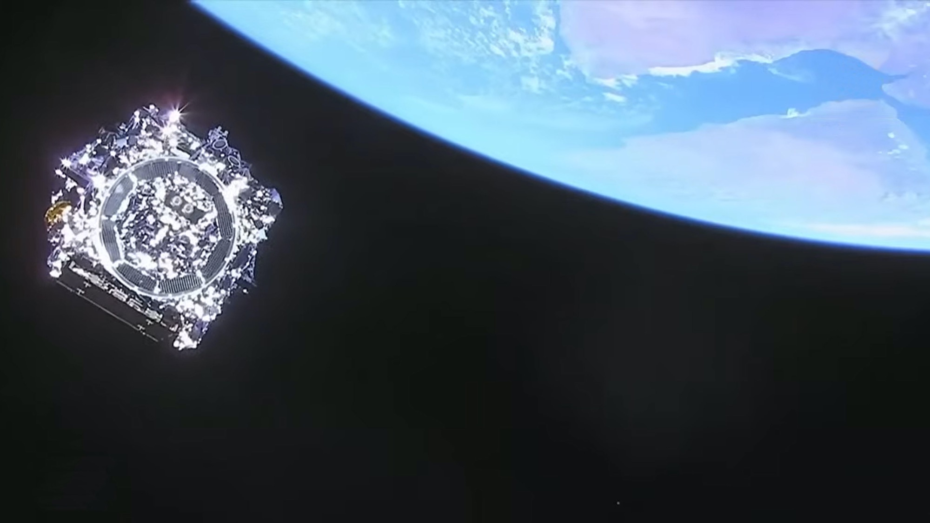
Webb’s Journey Begins
Notes:
The Ariane 5 rocket that carried Webb performed as expected, separating from the observatory 27 minutes into the flight.
At this point, engineers in Webb’s Mission Operations Center at the Space Telescope Science Institute in Baltimore, Maryland, took control.
__________________________
Resources:
Last view of the telescope (still image) from news release: https://webbtelescope.org/contents/media/images/2021/068/01FQRVPP8W778RA3TMD3TTBQ0H?news=true
Last view of Webb (video):
https://svs.gsfc.nasa.gov/14062#32370
Launch news release: https://webbtelescope.org/contents/news-releases/2021/news-2021-068
Image Credit: NASA, ESA
https://webbtelescope.org/contents/media/images/2021/068/01FQRVPP8W778RA3TMD3TTBQ0H

Slide 5
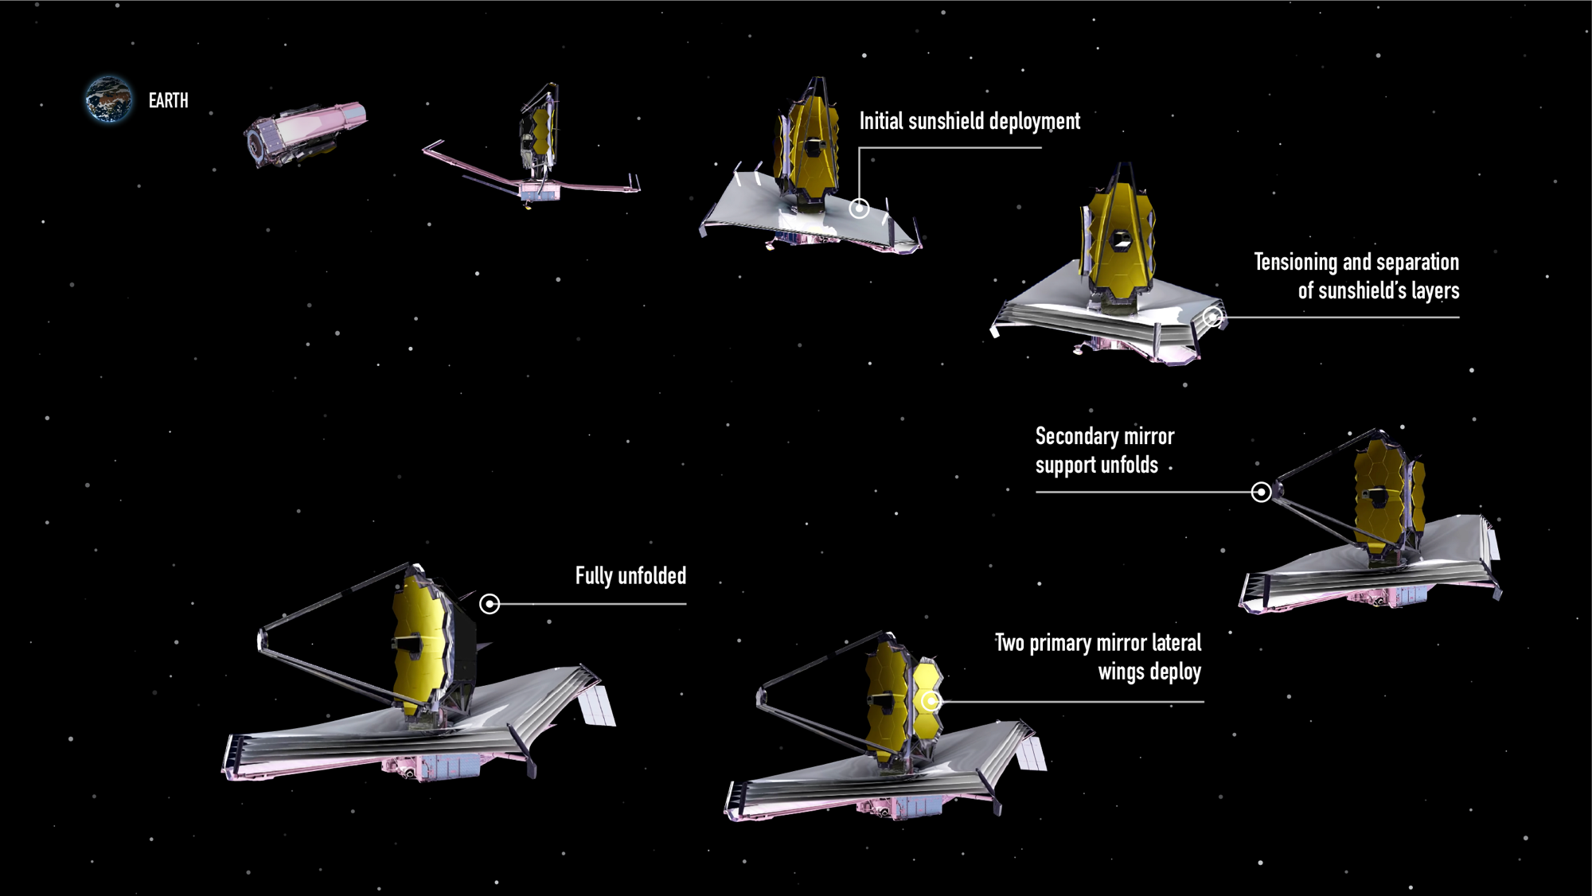

Webb’s Unfolding Sequence
Notes:
Engineers in Webb’s Mission Operations Center initiated and oversaw a carefully orchestrated series of major deployments.
After launch, Webb slowly unfolded while traveling to a location approximately 1.5 million kilometers (1 million miles) from Earth known as the second Sun-Earth Lagrange point (L2), a journey that took about a month.
Steps included:
Deploying, tensioning, and separating Webb’s sunshield, a five-layer, diamond-shaped structure the size of a tennis court,
Extending its secondary mirror support structure, and
Unfolding its primary mirror, which has a honeycomb-like pattern of 18 hexagonal, gold-coated mirror segments.
Throughout the next five months, engineers and scientists carefully activated and confirmed each and every instrument worked properly.
What made these innovations possible?
__________________________
FAQ:
Why do we have to wait so long between Webb’s launch and its first images?
In the six months after launch, Webb underwent a complex commissioning process. This included:
Deployments: This began when the telescope launched, on December 25, 2021, and continued for about 30 days. In a series of steps, Webb unfolded from its compact launch configuration. This included deploying, tensioning, and separating Webb’s sunshield, extending its secondary mirror support structure, and unfolding the wings of the primary mirror.
Telescope mirror alignments: This began just a month after launch and continued for about three months. Teams aligned Webb’s 18 hexagonal mirror segments so that they work together as one and are in focus for all of Webb’s four science instruments.
Science instrument calibrations: This began about four months after launch and continued for approximately two months. Webb’s instruments underwent a series of calibrations and tests. Engineers and scientists tested each mode to verify they are working as expected, understand their performance, and learn how to optimally extract science information.
During the deployment and alignment phases of commissioning, Webb cooled to its operating temperature. This slow, controlled cooling was necessary to prevent water that was outgassing from Webb to form ice on Webb’s optics and detectors and cold radiator surfaces, which would degrade the telescope’s performance.
More information: https://www.planetary.org/articles/jwst-first-images
Resources:
Webb’s unfolding sequence: https://webbtelescope.org/contents/media/images/01FJHQXZNXV0GWWJMCX69J57FD
Detailed post-launch deployment timeline: https://webbtelescope.org/contents/media/images/4180-Image
Article about aligning Webb’s mirrors: https://www.nasa.gov/feature/goddard/2017/aligning-the-primary-mirror-segments-of-nasa-s-james-webb-space-telescope-with-light
Webb’s orbit and view of the sky: https://webbtelescope.org/news/webb-science-writers-guide/telescope-overview
Video of Webb’s deployment sequence: https://www.youtube.com/watch?v=RzGLKQ7_KZQ
Illustration Credit: NASA, ESA, and J. Kang (STScI)
https://webbtelescope.org/contents/media/images/01FJHQXZNXV0GWWJMCX69J57FD

Slide 6
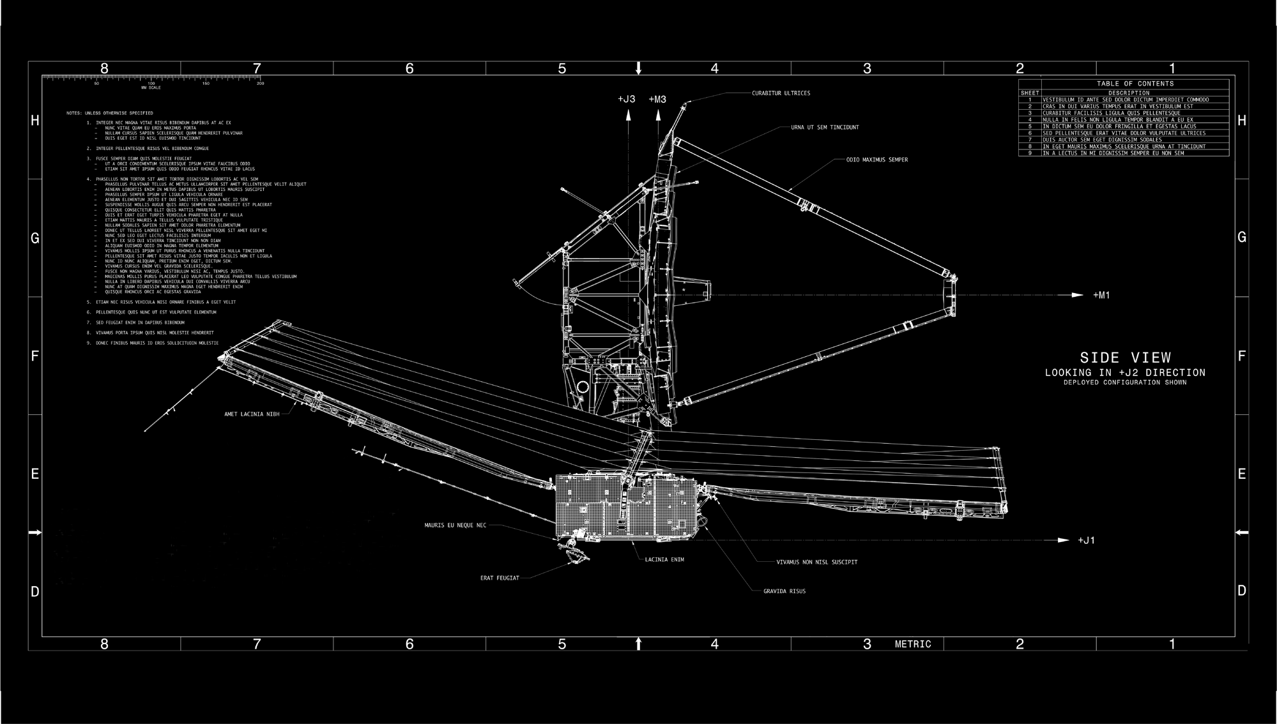
A Feat of Engineering
Notes:
Teams working on Webb designed several innovative and powerful new technologies that make its ambitious science goals possible.
Webb has specialized optics to align its mirrors, detectors that can capture and separate light from hundreds of sources at once, and custom thermal control systems.
The engineers who created these technologies made Webb the most sophisticated and complex space science telescope ever launched. And their diligent, hard work was easy to spot once Webb was in space.
_________________________
In-depth detail about the engineering:
Webb’s tennis-court-sized sunshield was deployed by 139 tiny mechanical motors called actuators, with the addition of eight motors, and thousands of other components, which unfolded and stretched the five membranes of the sunshield into its final taut shape. Every single movement was orchestrated precisely—and each one performed exactly as expected. Webb is a huge engineering success.
Webb’s primary mirror has 18 mirror segments that are adjusted to form a single, perfect focus. Each mirror segment has several actuators, or tiny mechanical motors attached to the back, allowing operators to independently move and adjust each mirror. Engineers conducted this complex alignment very carefully by executing tiny, precise movements for every segment.
Resources:
How Big Is Webb? article: https://webbtelescope.org/resource-gallery/articles/pagecontent/filter-articles/how-big-is-webb
Article about Webb innovations: https://www.jwst.nasa.gov/content/about/innovations/index.html
Webb Science Writer’s Guide Instrument Overview: https://webbtelescope.org/news/webb-science-writers-guide/telescope-overview
February 11, 2022 blog post: Beginning of mirror alignment, first Webb “selfie”:
https://blogs.nasa.gov/webb/2022/02/11/photons-received-webb-sees-its-first-star-18-times/
Webb science goals:
https://webb.nasa.gov/content/science/index.html
Image Credits: NASA

Slide 7
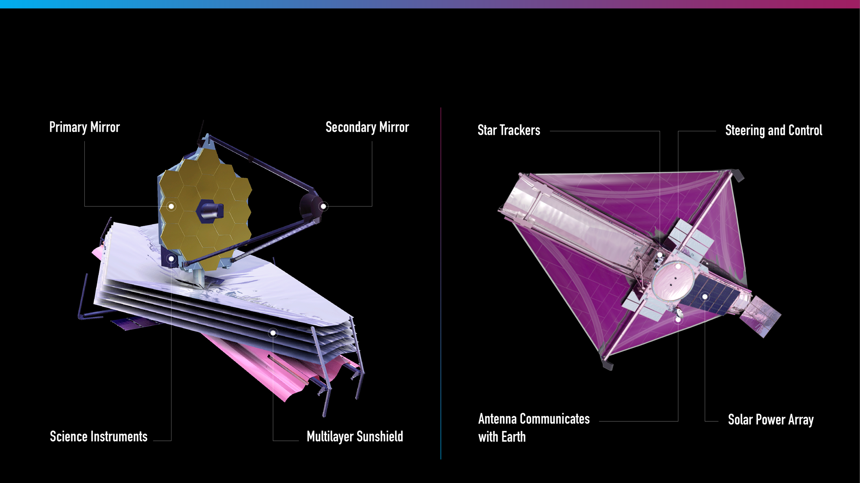
Observing Side
Sun-Facing Side
Notes:
The lower part of Webb, where its five-layered sunshield is, faces the Sun. This is where its equipment that does not need to be cooled, like its solar panel, antennae, computer, gyroscopes, and navigational jets, are.
Its tennis court-sized sunshield protects Webb from external sources of light and heat, which ensures it can detect faint infrared light from very distant objects.
It’s very important for its observing side, where all of Webb’s instruments are, to be very, very cold.
Webb’s science instruments are housed behind the mirror, separated by the sunshield from the warm communications and control technology.
Webb needs both passive and active cooling.
Its five-layered sunshield provides passive cooling. The first layer of the sunshield is two-thousandths of an inch (0.005 centimeters) thick, while the other four layers are only one-thousandth of an inch thick.
Let’s take a look at Webb’s instruments in a bit more detail.
__________________________
In depth:
Sunshield’s sun-facing layer estimated maximum temperature: ~400 K (260°F, 125°C)
Innermost layer of the sunshield estimated minimum temperature: ~40 K (–390°F, –235°C)
Keeps science instruments and mirrors passively cooled to 40 K (roughly –390°F, –235°C)
There is also a cryocooler, essentially a sophisticated refrigerator or air conditioner, to support one of the instruments (MIRI). This is the active cooling element that cools MIRI to approximately 7 K (–447°F, –266 °C).
Maintaining these temperatures ensures that Webb can gather a greater range of infrared light in space.
Without cooling, the only thing that Webb would see would be itself!
Since warm things glow in infrared light, Webb has to be cold or else its self-emission would produce enough background light that it would overwhelm faint sources. The colder Webb is, the fainter things it can see.
Resources:
Webb Science Writers’ Guide: https://webbtelescope.org/news/webb-science-writers-guide/telescope-overview
Webb’s Observing Side and Sun-Facing Side: https://webbtelescope.org/contents/media/images/4197-Image
Technical details: https://jwst-docs.stsci.edu/jwst-general-support/jwst-background-model
Image Credits: NASA, ESA, and J. Kang (STScI)

Slide 8
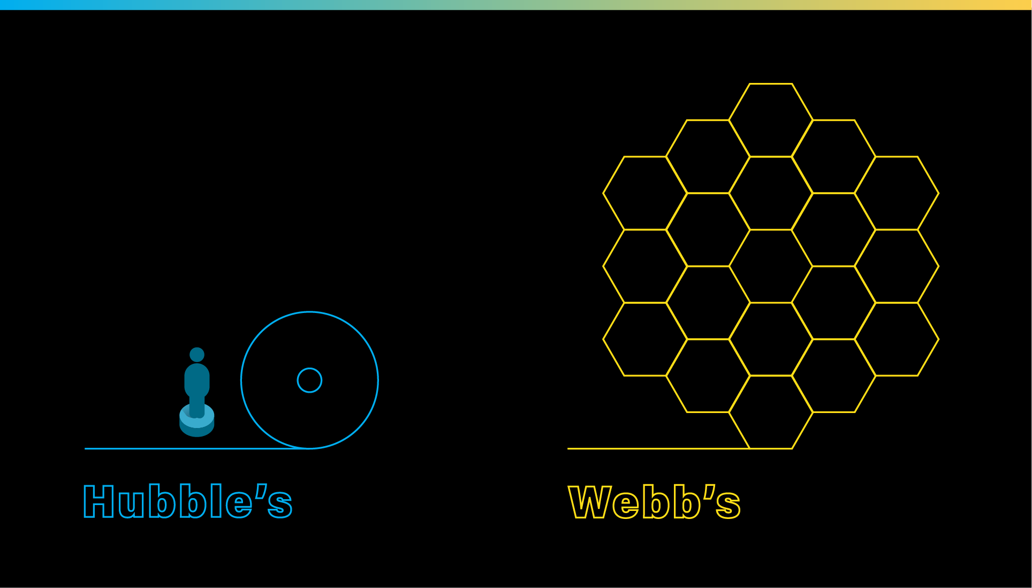
Capturing Faint, Infrared Light
PRIMARY MIRROR
PRIMARY MIRROR
Notes:
Webb has a 6.6-meter (21.7-foot) diameter primary mirror. It’s quite large—and there are several reasons why.
For context, Hubble's mirror is much smaller, at 2.4 meters (7.8 feet) in diameter.
Webb has to have a bigger mirror to capture high-resolution, Hubble-like details in infrared light.
Its mirror also needs to be stable at very cold temperatures—40 K (roughly –390°F, –235°C), which is why it is made of beryllium, which is six times stronger than steel and two-thirds the density of aluminum.
There are 18 hexagonal segments. They are hexagons so the mirrors can be adjusted to align to form a circular shape.
Each segment is coated in a very thin layer of gold—about 1,000 atoms thick! Gold was selected because it is the best reflector of infrared light.
Webb’s mirrors are like a bucket that collect light that’s immediately sent to its instruments. The more infrared light they gather, the more we can learn about the universe!
__________________________
Resources:
Webb’s mirrors: https://webbtelescope.org/news/webb-science-writers-guide/telescope-overview
https://webbtelescope.org/contents/media/images/01F6QV6RND28VX2T20V4PPAGMS
Hubble’s mirrors: https://hubblesite.org/mission-and-telescope/the-telescope
Video comparing Webb and Hubble’s mirrors: https://svs.gsfc.nasa.gov/13521
Video of the alignment of Webb’s primary mirror segments: https://svs.gsfc.nasa.gov/12895
Similar illustration: https://webbtelescope.org/contents/media/images/4181-Image
Video, “Hubble and Webb: Friends in the Sky”: https://webbtelescope.org/contents/media/videos/1279-Video
Illustration Credit: NASA, ESA, and J. Kang (STScI)

Slide 9
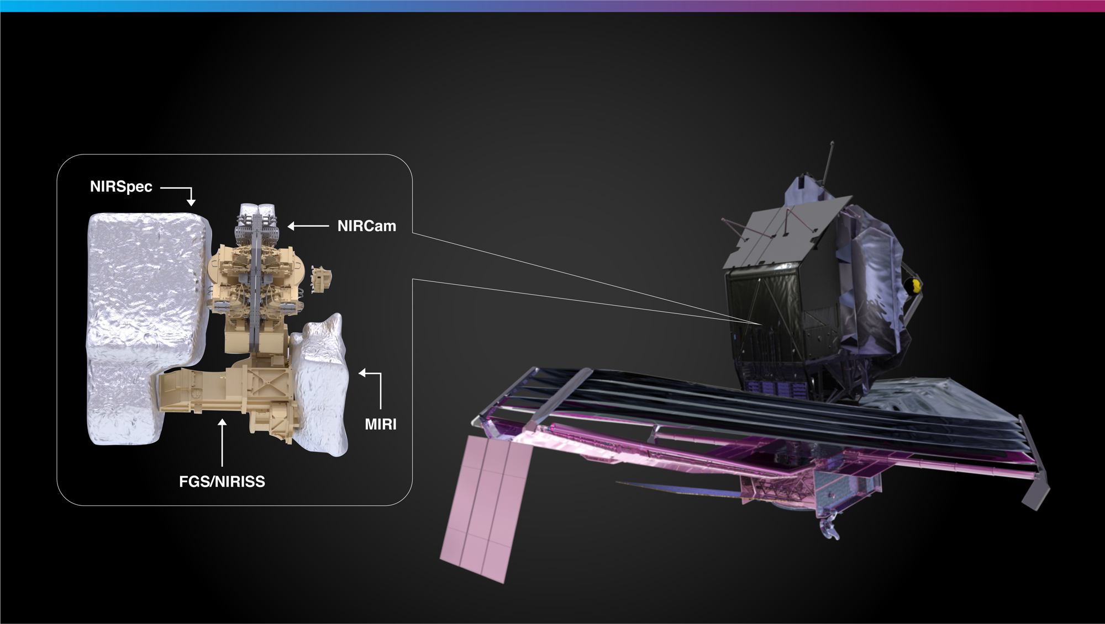
Webb’s Science Instruments
Notes:
Each instrument is like a Swiss army knife of more specialized components, with multiple ways of observing.
Although some instruments are more suitable than others for observing specific types of targets, all four can be used for investigations of the wide variety of objects that make up the universe, including planets, stars, nebulae, and galaxies.
__________________________
Instruments in depth:
Webb’s four science instruments are sensitive to a range of infrared light.
The Near-Infrared Spectrograph, or NIRSpec, is one of Webb’s versatile tools for near-infrared spectroscopy, which spreads out light into its component wavelengths like a rainbow. This allows researchers to study the composition of objects across the universe. This instrument has the first multi-object spectrograph in space, known as a microshutter array. It can capture individual spectra of dozens of objects at once, making it ideal for efficiently studying many distant, faint galaxies.
Webb’s Near-Infrared Imager and Slitless Spectrograph is combined with its Fine Guidance Sensor (NIRISS/FGS). NIRISS also gathers spectra—and photographs the universe at near-infrared wavelengths. It can study the composition of exoplanets’ atmospheres, observe distant galaxies, and examine bright objects that are very close together. FGS allows Webb to point precisely, so that it can obtain high-quality images.
Next up is the Near-Infrared Camera, or NIRCam, Webb’s primary imager or camera. It delivers high-resolution imaging and spectroscopy for a wide variety of investigations. It can detect light from the earliest stars and galaxies that are in the process of formation, stars in nearby galaxies, young stars in the Milky Way, and objects from a distant region of our solar system called the Kuiper Belt. It also can track the motion of exoplanets as they orbit their star.
The Mid-Infrared Instrument, or MIRI, is another powerhouse. It can take images and gather spectra—and it covers longer and redder infrared wavelengths of light. As the only mid-infrared instrument, astronomers rely on MIRI to study cooler objects like debris disks around stars, which emit most of their light in the mid-infrared, and extremely distant galaxies whose light has been stretched into the mid-infrared over time.
Spectrum definition:
A spectrum spreads out light. By looking at the resulting patterns in brightness across the spectrum, we can learn about the composition, surface temperature, density, and movement of objects in space.
Resources:
Overview of instruments: https://webbtelescope.org/news/webb-science-writers-guide/webbs-scientific-instruments
Individual instrument infographics:
NIRCam: https://webbtelescope.org/contents/media/images/01FA0SZSEW1TZ51BHG0EGW2EZP
NIRSpec: https://webbtelescope.org/contents/media/images/01FA0T08S2V810Y7ENZMGWTVDA
NIRISS: https://webbtelescope.org/contents/media/images/01FA0T0WM3X65FFXM0JBR4C5ZB
MIRI: https://webbtelescope.org/contents/media/images/01FA0SZA5HPXKRKH8Y6PKB10V1
Microshutter infographic
https://webbtelescope.org/contents/media/images/4673-Image
Eclipse/coronagraph animation: https://webbtelescope.org/contents/media/videos/2019/29/1210-Video
Webb’s Instrument Wavelength Coverage: https://webbtelescope.org/contents/media/images/4207-Image
Image Credit: NASA, ESA, and J. Kang (STScI)

Slide 10
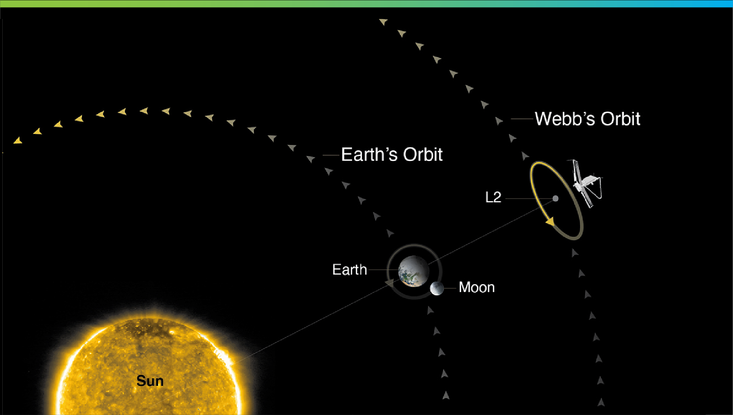

Where Is Webb’s Orbit?
Not to scale
Notes:
Webb orbits the Sun near the second Sun-Earth Lagrange point—often referred to as L2. This point is approximately 1.5 million kilometers (930,000 miles) from Earth, “behind” the Earth as viewed from the Sun. L2 moves in lockstep with the Earth as it rotates around the Sun, completing one orbit in one year.
Webb can’t orbit the Earth like Hubble, because the visible and infrared light from the Sun, Earth, and Moon would heat up the telescope’s mirror and scientific instruments, causing the telescope itself to glow in infrared light—and that would outshine the faint objects in space that Webb observes.
Webb’s sunshield always faces the Sun. This ensures its mirrors and instruments, which always face away from the Sun, are always cool.
At L2, Webb can maintain a safe distance from the bright light of the Sun, Earth, and Moon—while also remaining in contact with us on Earth.
__________________________
FAQ:
What is a Lagrange point?
Lagrange points, discovered by mathematician Joseph Louis Lagrange, are special equilibrium points for small objects (like a spacecraft or an asteroid) orbiting two much larger objects (like the Earth and the Sun). At these points in space, the gravity of the two large objects balance the orbital motion of the third object. Lagrange points can be used by spacecraft to reduce propellant consumption needed to remain in position.
There are five Lagrange points for any system, labeled L1 to L5. Of the five points, three are unstable and two are stable. The unstable Lagrange points—L1, L2, and L3—lie along the line connecting the two large masses. Spacecraft orbiting at these points need to perform station keeping to remain their orbits, by periodically expending small amounts of propellant. The stable Lagrange points—L4 and L5—occur at the apex of two equilateral triangles that have the large masses at their vertices. L4 leads the orbit of Earth and L5 follows.
See the diagram here: https://solarsystem.nasa.gov/resources/754/what-is-a-lagrange-point/
Webb orbits around the second Sun-Earth Lagrange point (L2). This point is approximately 1.5 million kilometers (930,000 miles) from Earth, “behind” the Earth as viewed from the Sun. All Lagrange points move in lockstep with the Earth as it rotates around the Sun, completing an orbit in one year.
Are there other spacecraft that orbit at L2?
Yes. There are several spacecraft that orbit or have orbited at L2. They include the Herschel Space Observatory, the Gaia space observatory, the Planck space observatory, and the Wilkinson Microwave Anisotropy Probe (WMAP).
Does Webb orbit exactly at L2?
No. Webb will orbit around L2, not sit stationary precisely at L2. If Webb were located exactly at L2, it would see the Sun eclipsed by the Earth, blocking the power it receives on its solar arrays. Webb loops around L2 in a six-month, tilted, elliptical orbit, which is slightly larger than the size of the Moon’s orbit around the Earth. This ensures that spacecraft never falls into the shadow of the Earth or the Moon—and remains charged. Here is a diagram of the obit to scale: https://www.flickr.com/photos/nasawebbtelescope/51886649707
What is Webb’s anticipated lifetime?
Webb will contain enough propellant for about 20 years of maneuvers at L2, and the Webb Science and Mission Operations Center at the Space Telescope Science Institute (STScI) will have the ability to adjust the science operations of the observatory to maximize potential as it ages. NASA engineered Webb so that all critical subsystems are dual or will degrade gracefully with age. For instance, the Near Infrared Camera (NIRCam) has two identical camera systems so that the optical quality can be maintained even if one fails.
How much of the sky can Webb see?
Over the course of six months, as Webb orbits the Sun with Earth, it has the ability to observe almost any point in the sky. Webb’s field of regard is limited to a 50-degree swath of the celestial sphere: About 39% of the sky is potentially visible to Webb at any given time. Because Webb must face away from objects that are warm and close enough to interfere with its ability to observe faint infrared light, it cannot observe the Sun, Mercury, Venus, Earth, the Moon, or other objects as they pass through the inner Solar System.
Can we can service Webb?
The quick answer is no. To meet Webb’s science goals, the telescope has to be far away from the heat of the Earth. This is why the telescope had to be so thoroughly tested before launch. This isn’t the first mission that is unserviceable. Other space telescopes, such as Spitzer and Herschel, successfully completed their missions in unserviceable orbits.
Resources:
Webb Science Writers’ Guide: https://webbtelescope.org/news/webb-science-writers-guide/telescope-overview
Article about Webb’s orbit, including illustrations and a video: https://webb.nasa.gov/content/about/orbit.html
Webb’s Orbit illustration: https://webbtelescope.org/contents/media/images/4201-Image
Additional detail about Webb’s orbit to help explain the details: https://www.ariane.group/en/news/how-lagrange-point-2-meets-james-webbs-checklist-for-an-ideal-home/
Video of Webb’s orbit:
https://webbtelescope.org/contents/media/videos/01F51C6VAPFHS6ZK5R29G2NDVG
Video about Webb’s field of regard: https://webbtelescope.org/contents/media/videos/1157-Video
Answers to frequently asked questions: https://www.jwst.nasa.gov/content/about/faqs/faq.html
Image Credit: STScI
https://webbtelescope.org/contents/media/images/4201-Image

Slide 11
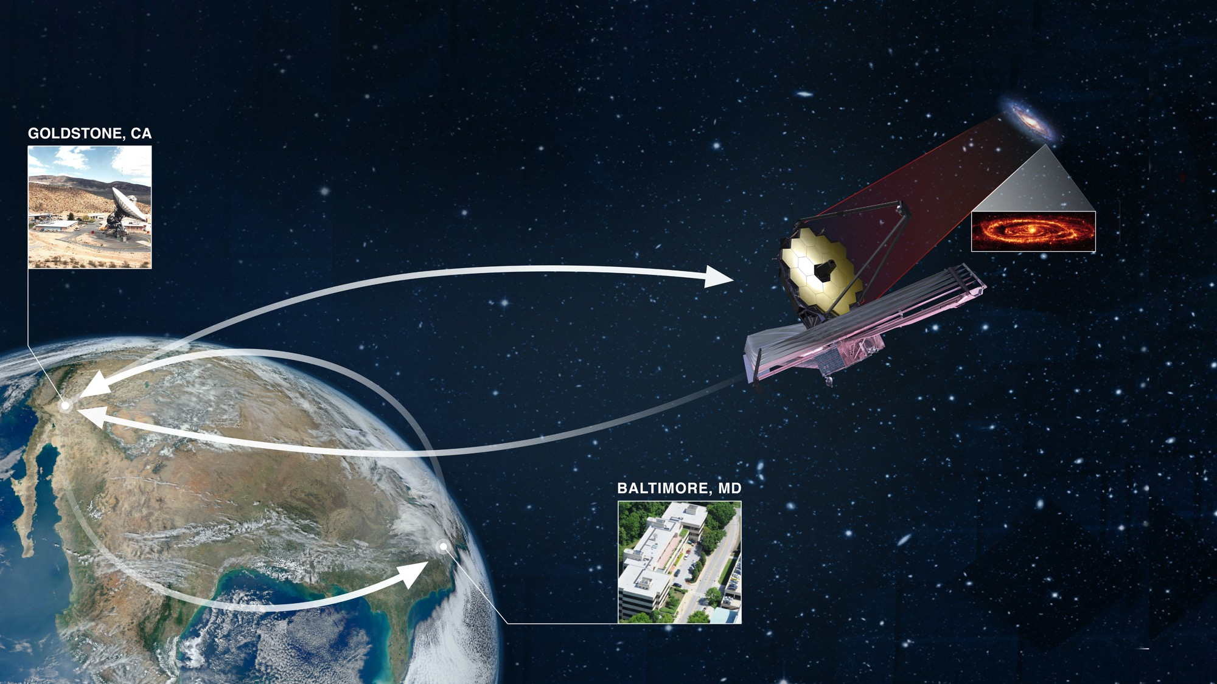
How We ‘Talk’ to Webb
Notes:
Every great relationship is based on excellent communication!
The Space Telescope Science Institute (STScI) in Baltimore, Maryland, plays a key role in communicating with Webb—STScI hosts Webb’s Mission Operations Center, where engineers and scientists command and control the telescope.
Commands from STScI travel to the Deep Space Network, or DSN, which transmits them to Webb.
Webb’s data are returned through the Deep Space Network to STScI, where they are processed, distributed to the scientific community, and added to STScI’s publicly accessible archive.
__________________________
FAQ:
How much data will Webb transmit each day?
Webb can downlink at least 57.2 gigabytes of recorded science data each day, with a maximum data rate of 28 megabits per second.
How long does data take to travel from Webb to Earth?
Traveling at the speed of light, it takes about 5 seconds for data to travel from Webb in its orbit around L2 to the Earth. All communications are routed through NASA’s Deep Space Network, with three ground stations located in Canberra, Australia, Madrid, Spain, and Goldstone, California.
Which frequencies do we use to communicate with the telescope?
S-band frequencies are used for command uplink, low-rate telemetry downlink, and ranging. Ka-band frequencies are used for high-rate downlink of science data and telemetry.
Resources:
Graphic shown on slide: https://webbtelescope.org/contents/media/images/01F6850HZ2K7FY8P8A8KBC54FQ
Details about how STScI will communicate with Webb (replace “testing” references with actual commands if you add these details to your presentation notes): https://www.stsci.edu/contents/annual-reports/2019/rehearsing-for-launch
Watch Webb’s data transmission: https://eyes.nasa.gov/dsn/dsn.html
Technical details about Webb’s communications system: https://jwst-docs.stsci.edu/jwst-observatory-hardware/jwst-spacecraft-bus/jwst-communications-subsystem
The Mikulski Archive for Space Telescopes (MAST), home to Webb’s data:
https://archive.stsci.edu/
Image Credit: NASA, ESA, CSA, Elizabeth Wheatley (STScI) https://webbtelescope.org/contents/media/images/01F6850HZ2K7FY8P8A8KBC54FQ

Slide 12
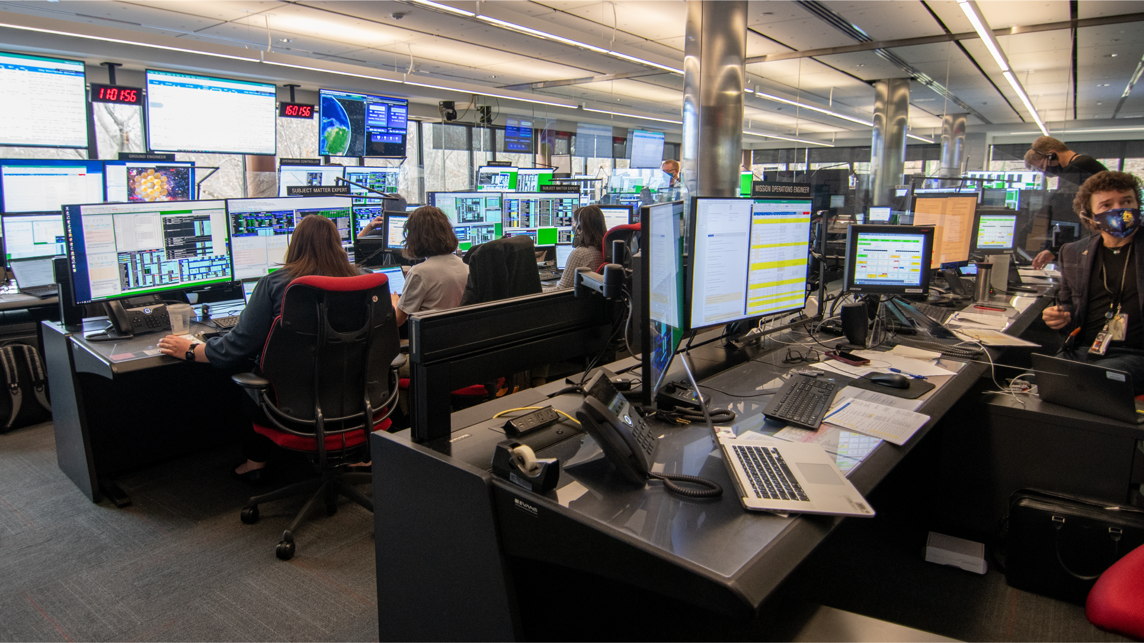
Commanding Webb
from Baltimore, Maryland
Notes:
Want to pretend you are sending commands to Webb? Imagine you’re in Webb’s Mission Operations Center at the Space Telescope Science Institute (STScI) in Baltimore, Maryland.
STScI’s engineers sit at the controls—they send commands to Webb, which the telescope executes. They are supported by scientists and team members from the mission’s partners. The team also continuously monitors the health of the telescope.
Engineers have controlled Webb since the telescope fully separated from its launch vehicle 27 minutes after liftoff.
They also initiated and oversaw all major deployments as Webb slowly unfolded while traveling to the second Sun-Earth Lagrange point (L2), which is approximately 1.5 million kilometers (1 million miles) from Earth.
During the first six months of 2022, engineers and scientists fully commissioned every instrument on Webb.
What is commissioning? It involves hundreds of precise, choreographed activities. First, engineers executed commands to carefully unfold the telescope’s mirrors. Then they aligned each mirror segment so they work together to produce one, clear image.
They also tested every mode on every instrument, taking images and spectra as they went, to ensure that everything works as planned.
And it does! This is a major feat that we can all be proud of.
This team prepared for years for these moments. And now, they are executing science proposals for astronomers who received time to observe with Webb.
__________________________
FAQ:
How long does data take to travel from Webb to Earth?
Traveling at the speed of light, it takes about 5 seconds for data to travel from Webb in its orbit around L2 to the Earth. All communications are routed through NASA’s Deep Space Network, with three ground stations located in Canberra, Australia, Madrid, Spain, and Goldstone, California.
Resources:
Overview of Webb’s commissioning activities from launch to the beginning of science operations: https://jwst.nasa.gov/content/webbLaunch/deploymentExplorer.html
Firsthand account from three members of the Flight Operations Team at STScI: https://www.stsci.edu/contents/annual-reports/2021/front-row-seats
2019 graphic article that shows how everyone collaborates in Webb’s Mission Operations Center (note that these graphics were created during rehearsals): https://www.stsci.edu/contents/annual-reports/2019/rehearsing-for-launch
2018 release about communications in the Mission Operations Center: https://webbtelescope.org/contents/news-releases/2018/news-2018-31
Video: “Seeing New Frontiers with NASA's James Webb Space Telescope”: https://universeunplugged.ipac.caltech.edu/video/ata-21-12-09
Baltimore Magazine article about STScI’s James Webb Space Telescope Science Policy Group Lead Astronomer Dr. Christine Chen: https://www.baltimoremagazine.com/section/gamechangers/jhu-astronomer-christine-chen-decides-who-will-use-james-webb-space-telescope/
Baltimore Magazine article, “Baltimore Scientists Unveil the Universe with the James Webb Space Telescope”: https://www.baltimoremagazine.com/section/sciencetechnology/baltimore-scientists-unveil-the-universe-with-james-webb-space-telescope/
Watch Webb’s data transmission: https://eyes.nasa.gov/dsn/dsn.html
Image Credit: NASA, (Jaclyn Barrientes) STScI.

Slide 13
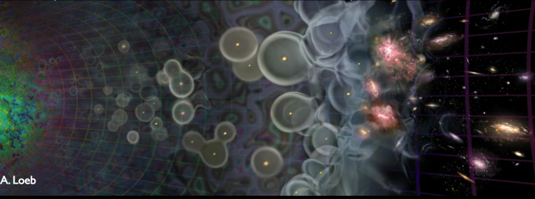
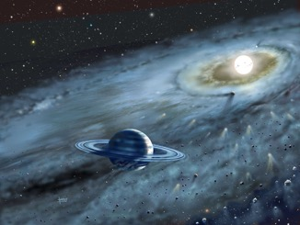
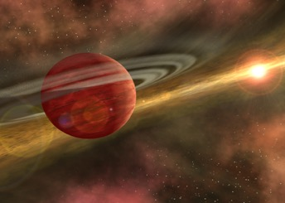
JWST – the mission in a few sentences
High-sensitivity, low-background, imaging, spectroscopic and coronagraphic capabilities over the 0.6-29 micron wavelength range.
Very powerful and versatile observatory with broad science goals.
From the first galaxies to our Solar system.

Slide 14
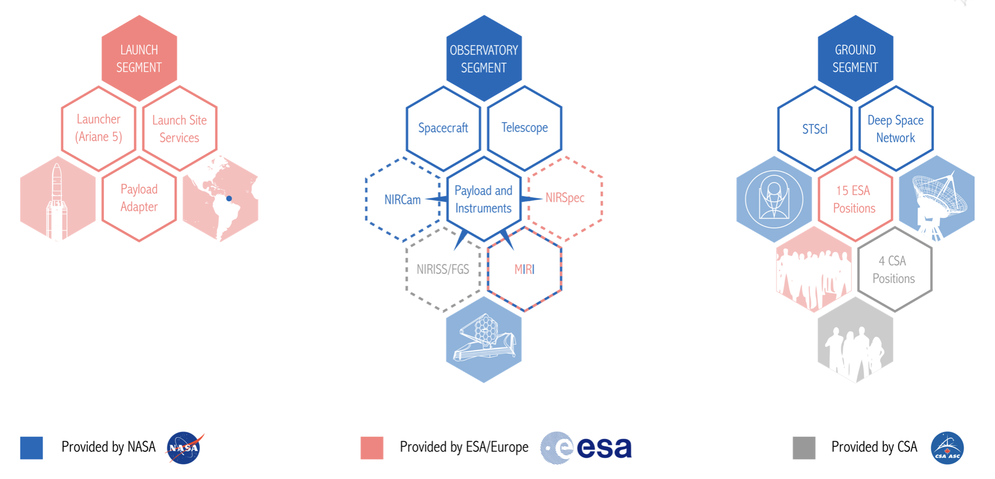
JWST – an international collaboration

Slide 15
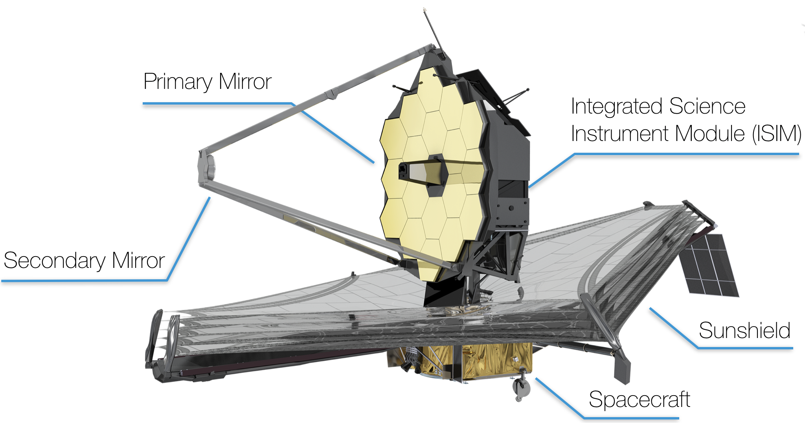
JWST – Main building blocks
JWST observatory
SCE = spacecraft + sunshield
OTIS = telescope + instruments

Slide 16
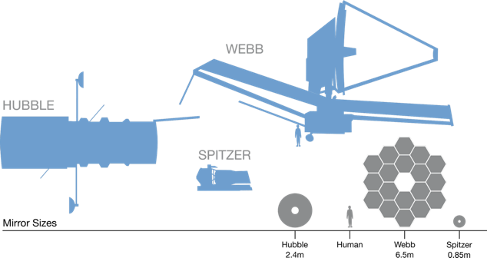
JWST – Main building blocks

Slide 17
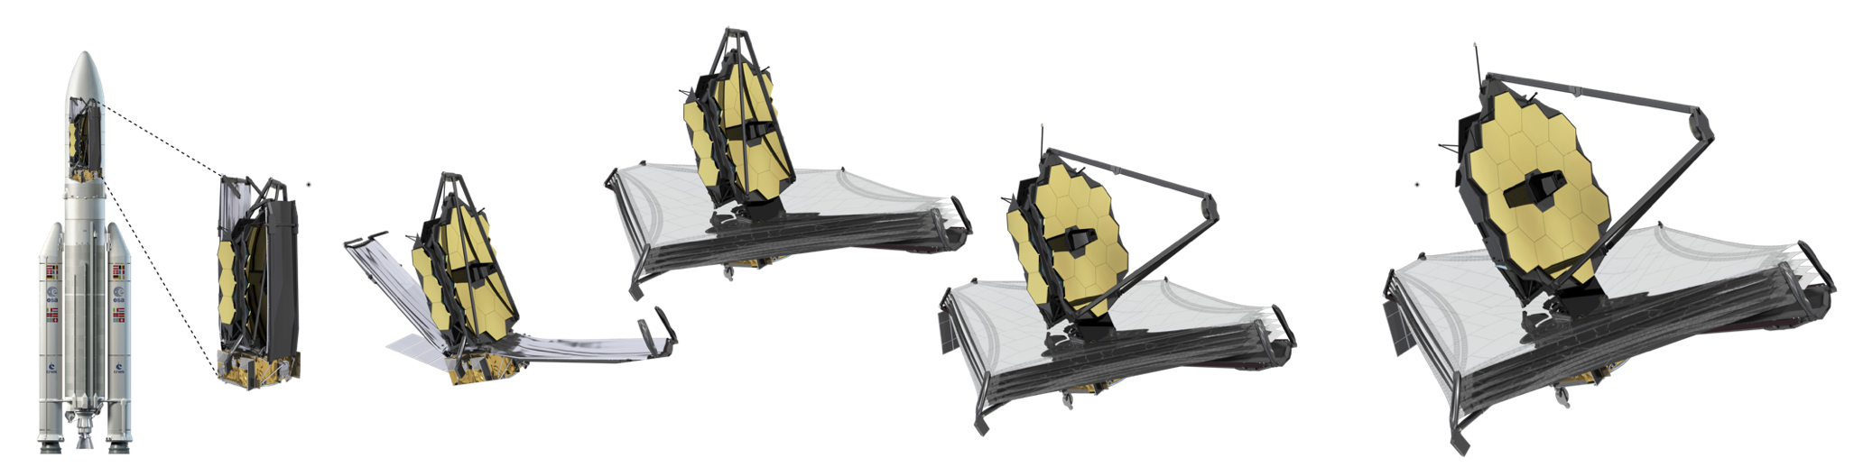
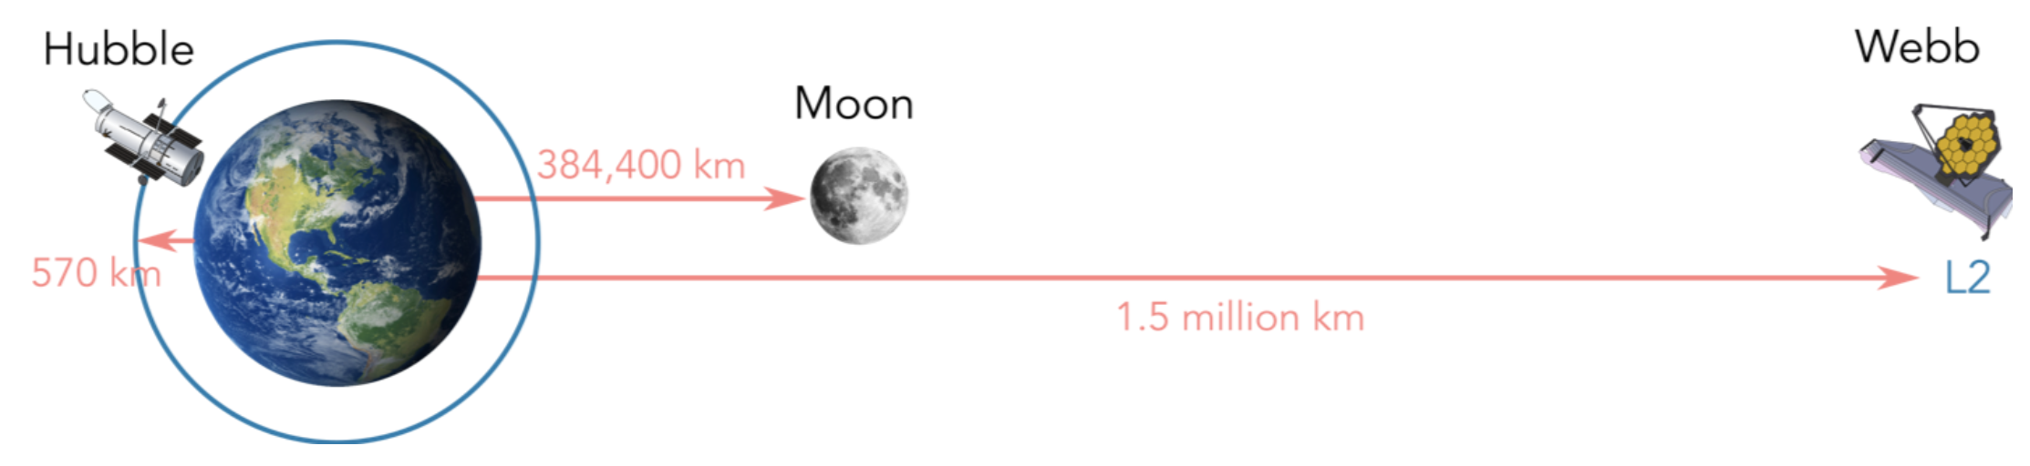
JWST – a deployable observatory

Slide 18
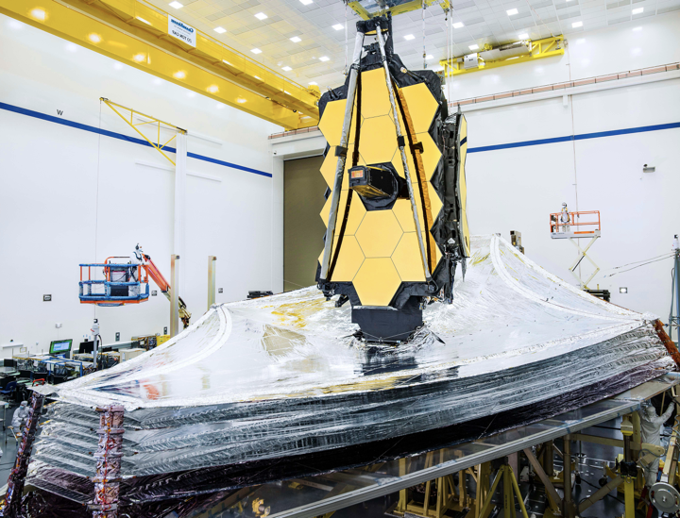
JWST – observatory status
A major, long awaited milestone was passed at the end of August 2019.
For the first time, all JWST elements were integrated together, the JWST “observatory” was born!
Credit: NASA/Chris Gunn

Slide 19
JWST – the mission in a few sentences
Flagship mission that will be one of the great observatories of the 2020s.
Often presented as the next step after the Hubble Space Telescope. The good news is that we expect JWST and HST to overlap (very complementary).
A partnership between NASA, ESA and CSA.
High-priority endeavor for the associated astronomical communities.
To be launched in March 2021 for a minimum mission duration of 5 years.
Enough consumables for at least 10 years.
6.5-meter diameter segmented telescope passively cooled to < 50K.
To be launched by an Ariane 5 rocket.
Orbit around the Sun-Earth L2 point.

Slide 20
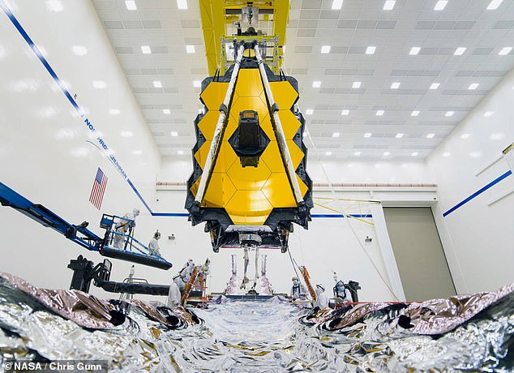
JWST – observatory status
Impressive image of OTIS (telescope and instrument) as it was slowly and carefully lowered to be installed on the SCE (spacecraft and sunshield) in August 2019.
Credit: NASA/Chris Gunn

Slide 21
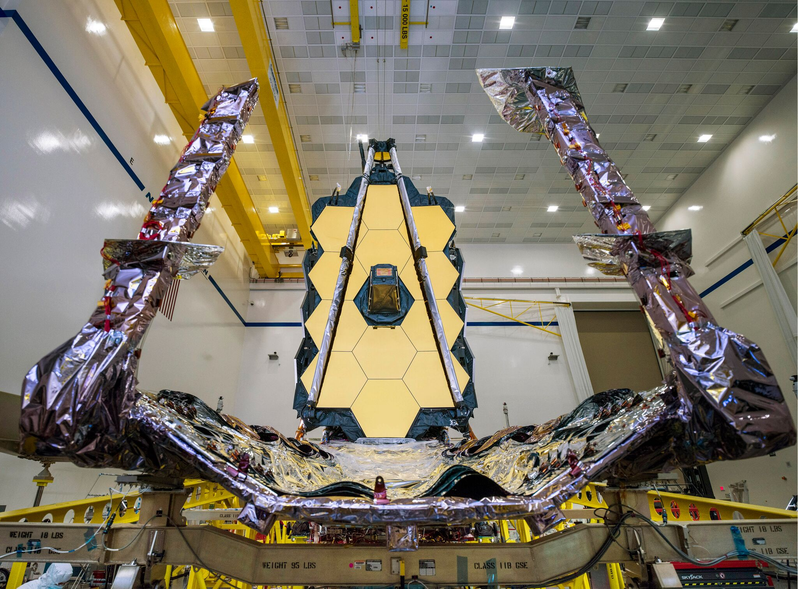
JWST – observatory status
But JWST still has a lot of activities planned before the observatory can be shipped to Kourou in French Guyana to be integrated on the Ariane 5 rocket.
2020 will be another busy year for the JWST team.
Credit: NASA/Chris Gunn

Slide 22
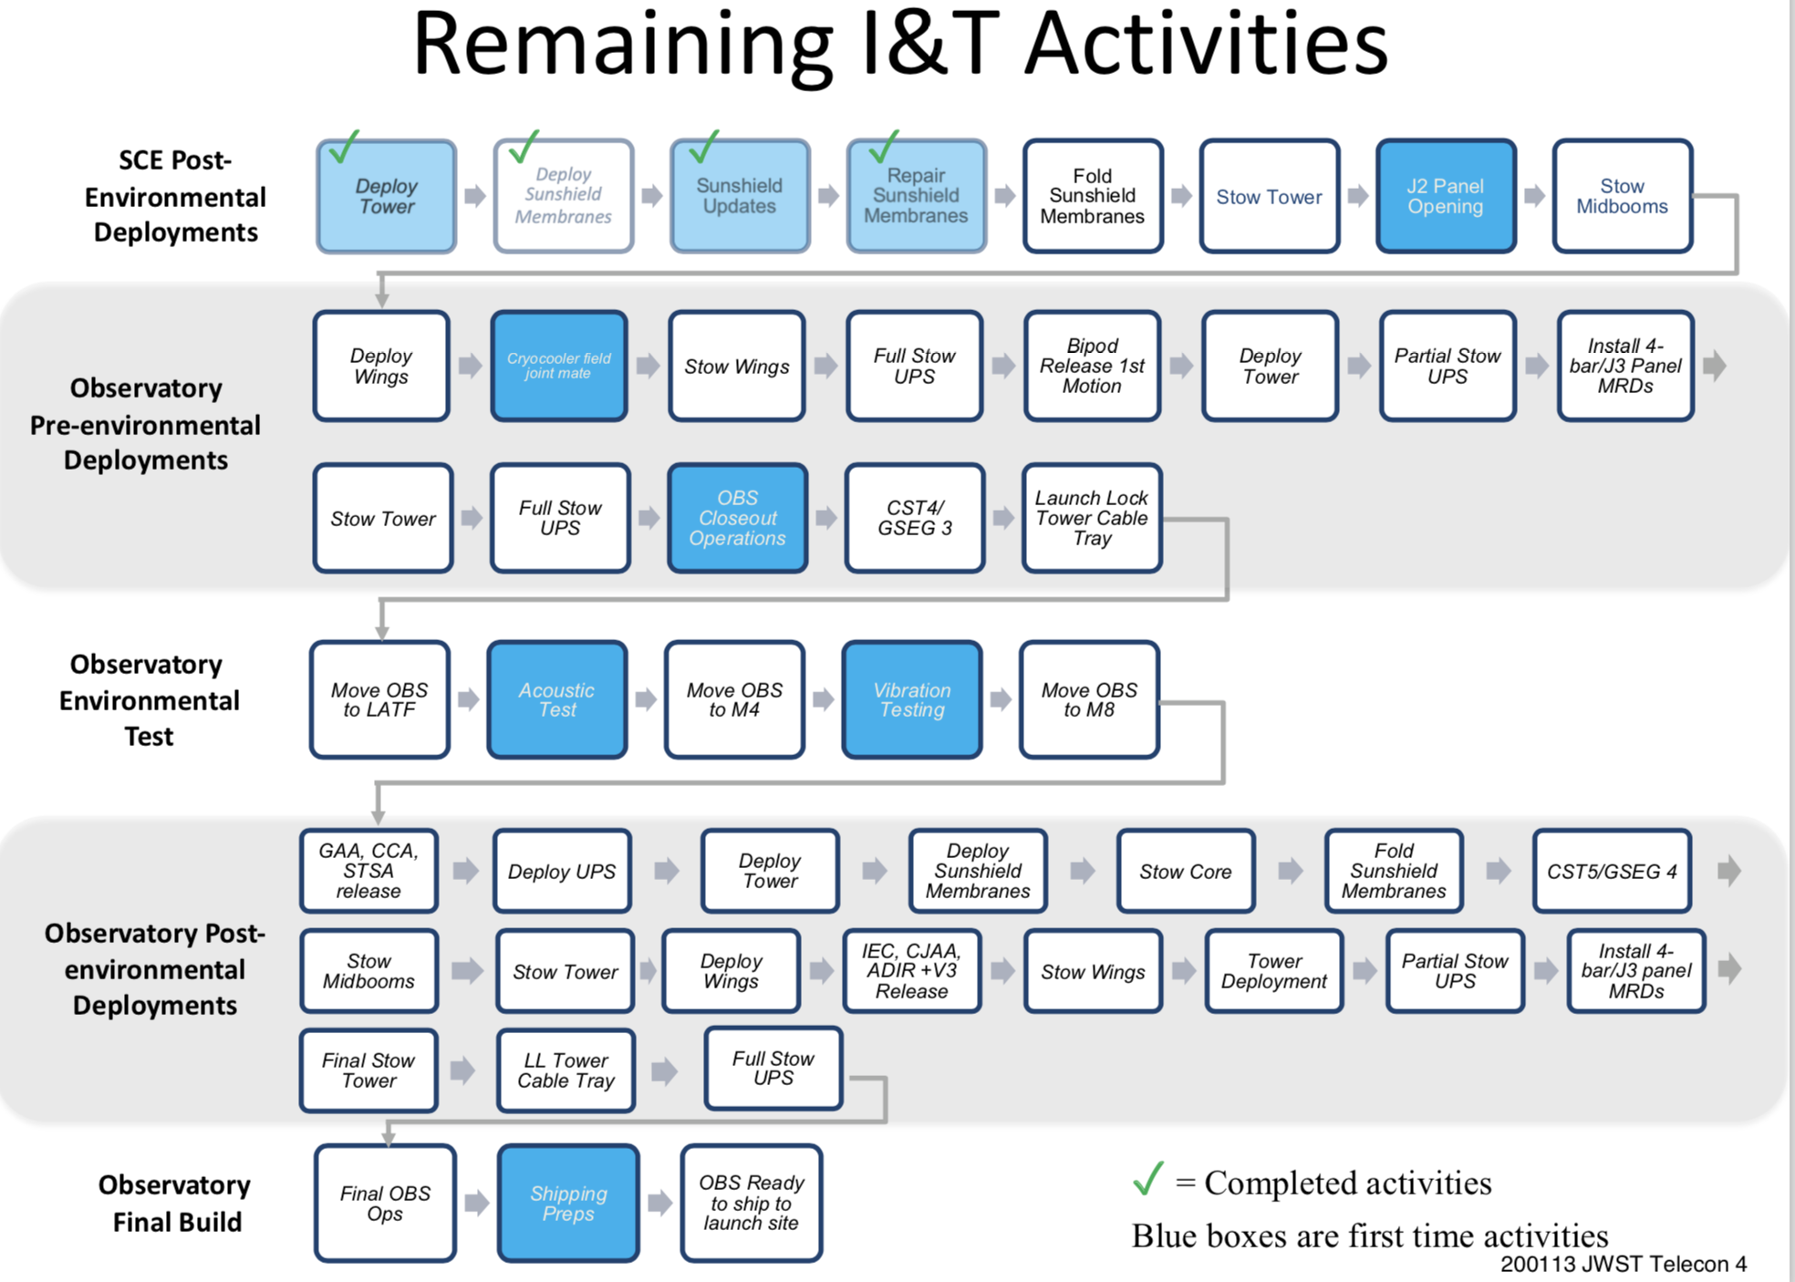
JWST – next steps
I&T = integration and testing
SCE = spacecraft and sunshield
From now…
First time activities highlighted in blue.
The vast majority of activities are not done for the first time.
Status 13 January 2020 – presentation E. Smith (NASA)
Checks before observatory testing
Major observatory-level test activities (mid-2020)
Final deployment and stowing tests
To the end of 2020!
Shipping!

Slide 23
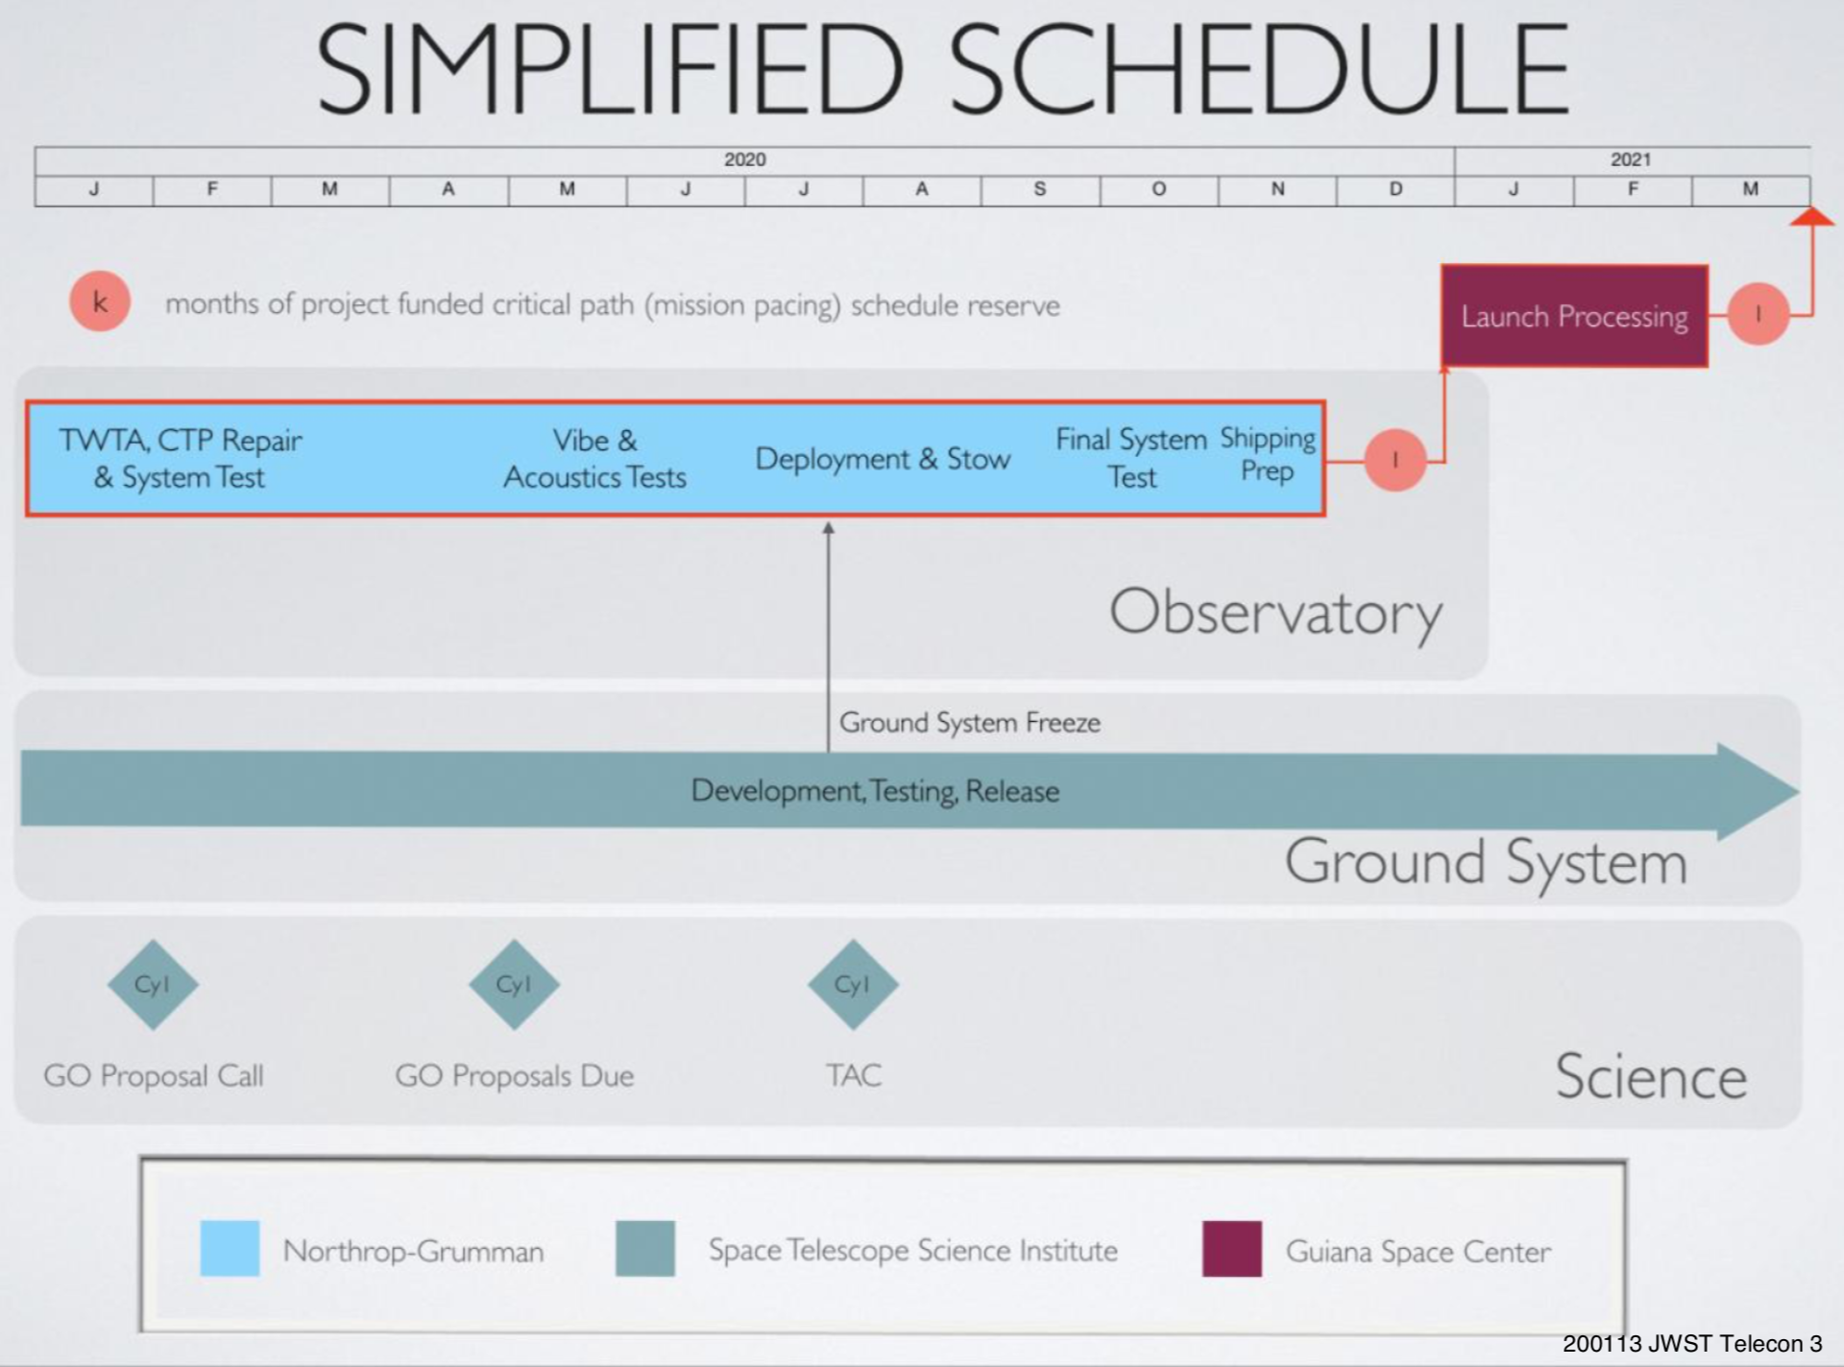
JWST – observatory status
Launch is still planned for March 2021 with the observatory arriving in Kourou at the end of 2020.
JWST still has some schedule margin (2 months) but schedule is tight.
Status 13 January 2020 – presentation E. Smith (NASA)

Slide 24
JWST status - conclusion
JWST is on track for a launch in March 2021!
2020 will be a very busy year for the JWST team as engineers and scientists work to ready it for its shipping to the launch site in French Guyana at the very end of the year!
Thanks for your attention.

